Slide 1
Scalability of Policy Gradient Reinforcement Learning (RL)
Nicholas Abate

Slide 2
The Problem: scalability
Deep reinforcement learning is most popular modern RL method
Computational complexity exponentially increases as state space increases
Proximal Policy Optimization and Trust Region Policy Optimization
How do they compare when scaling state space?

Slide 3
Reinforcement Learning
General Structure
For x steps in an iteration
Agent reads s_{t} from the environment
Agent predicts most viable a_{t}
Agent runs a_{t} in the environment
Environment passes s_{t+1} and r_{t+1} to agent
Repeat
Agent
s_{t} , r_{t}
a_{t}
Environment
Key
s_{t} – State at step t
r_{t} – Reward at step t
a_{t} – action at step t

Slide 4
Policy Optimization
Proximal Policy Optimization (PPO)
First published in 2017 – John Schulman and OpenAI
Can be used for discrete and continuous action spaces
Exploration
PPO Clip
Trust Region Policy Optimization (TRPO)
Also discrete and continuous action spaces
Popularized for its safe exploration
KL Constraint
Common use case
Training a robot in the field

Slide 5
Implementation
Tools
Tensorflow, Keras, OpenAI gym
Neural Networks
Separate networks for policy and value function
Two hidden layers each
Hidden layer size dependent on input size
PPO Tutorial
Tutorial introduced me to using Keras
Implemented PPO Clipping and TRPO KL Constraint referencing OpenAI’s pseudocode

Slide 6
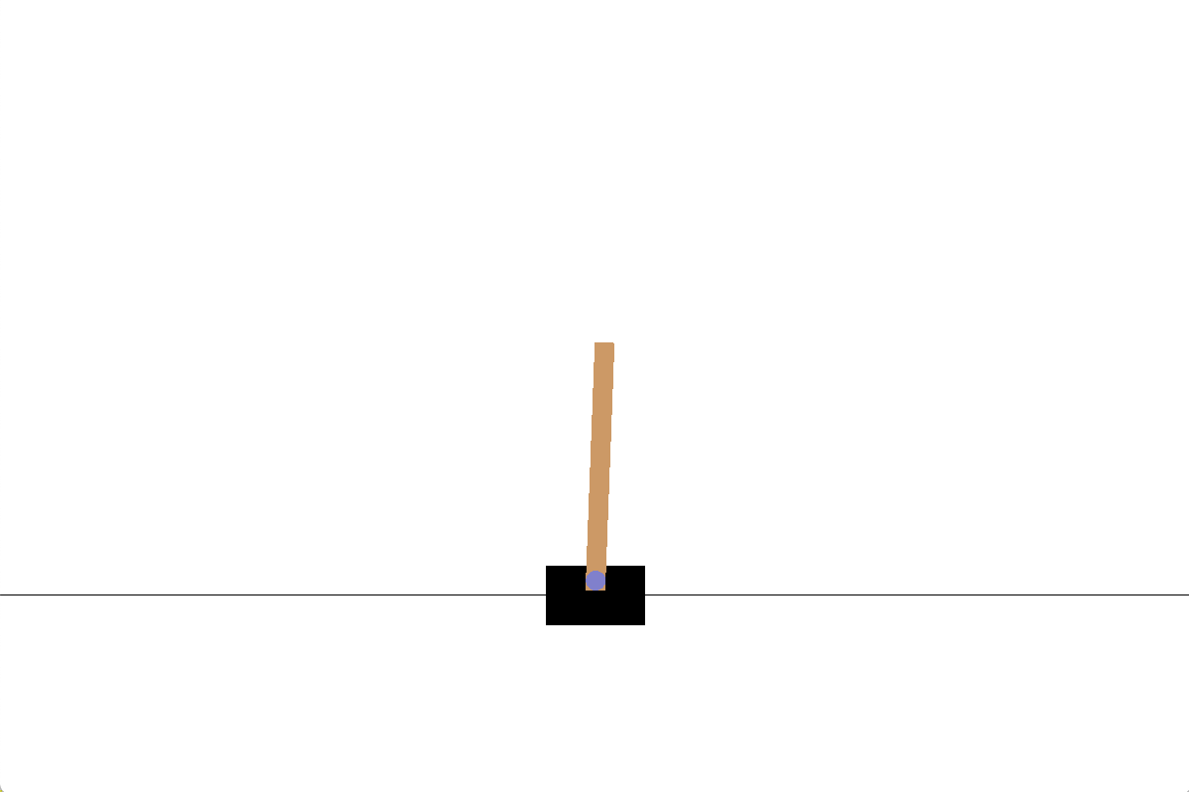
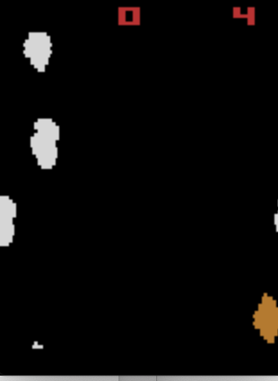
Experiments
Cartpole
Asteroids RAM
State Space
2 continuous variables
Orientation of Pole
State Space
128 discrete variables
RAM contents

Slide 7
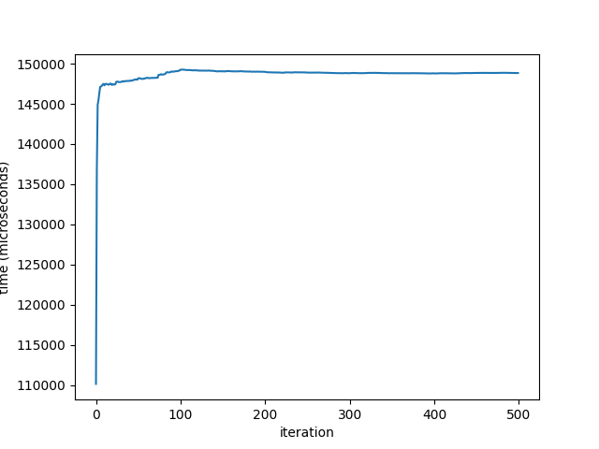
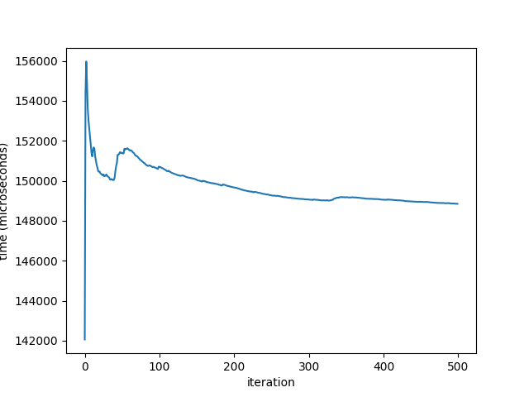
Cartpole
PPO Results
TRPO Results

Slide 8
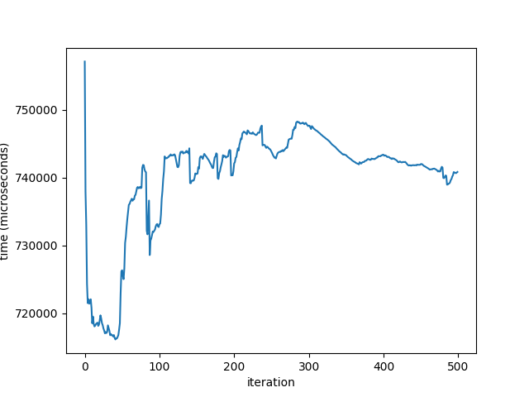
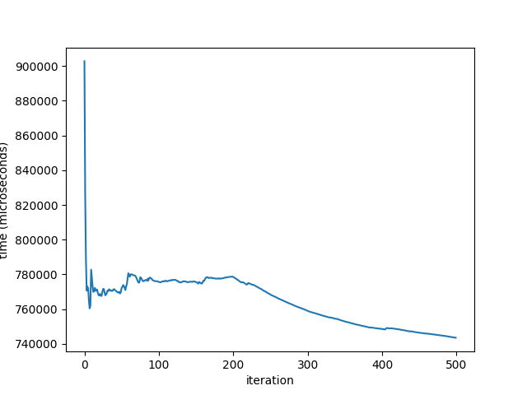
Asteroids RAM
PPO Results
TRPO Results

Slide 9
Conclusions
TRPO’s Slow Start
TRPO’s scalability
Initial learning takes much longer
Eventually approaches PPO’s time-per-iteration
Why?
Likely due to KL-Constraints calculation demand
TRPO’s time difference only increased with state space
Why?
Slower exploration implies slower time-per-iteration

Slide 10
Thank You

